Slide 1

Mockito Test Framework
Unit Testing with Mock Objects
TESTS ARE EASIER IF YOU
THINK OF THEM AS EXIT POLLS.

Slide 2


Unit Test
Tests one responsibility of a single class (called the “System Under Test” or SUT).
Verifies that the code in an SUT works.
Challenges:
Simplify testing
Provide control of the execution context
Enter “Test Doubles”:
Fake replacements for live resources during testing.

Slide 3

Common problems in Unit Testing
How to write unit tests if the SUT depends on some of the following components:
^{Database access code}
^{LDAP server access code}
^{Not yet implemented classes}
Components which supply non-deterministic results (e.g.
^{Remote classes}
Gateways to legacy code or systems
^{Web service proxy classes}
^{Facades to other subsystems}
^{Slow components}
^{current time or current} ^{temperature);}

Slide 4
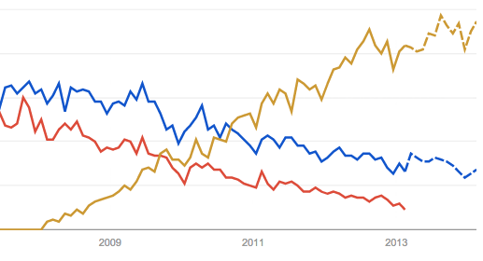
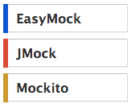
Google Trends Java Mocking Frameworks

Slide 5
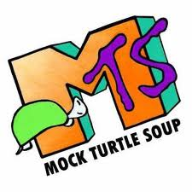
Five Categories of Mock Objects
Dummy Empty object passed in a method call (to satisfy a compiler when a non-null method argument is required).
Fake Simplified object for testing, (e.g., an in-memory database).
Stub Hardcoded behavior for a given set of tests.
Mock An object with the ability to
have a programmed expected behavior, and
verify the interactions occurring in its lifetime.
Spy A mock created as a proxy to an existing real object; some methods can be stubbed, while the un-stubbed ones are forwarded to the covered object.

Slide 6
Best Practices
It’s ok to copy and paste, but don’t get caught! Refactor as soon as it is working.
Never leave a catch block empty.
The proper way to propagate an InterruptedException is Thread.currentThread().interrupt();
Learn Eclipse keyboard shortcuts. You will be more productive.
Learn all Eclipse refactorings.
Don’t abbreviate. If you are a slow typist, abbreviate but rename when you’re done.
Concurrency is hard impossible. Use API’s, tools, and use immutable objects where possible.

